Slide 1


Welcome you all
MongoDB
D.Sakthivel
Assistant Professor & Trainer,
KGiSL Micro College
KGiSL Campus, Coimbatore – 641 035.

Slide 2
Day 1
What is MongoDB?
Install MongoDB
MongoDB Server
MongoDB Shell
MongoDB Shell Commands
MongoDB Compass

Slide 3

MongoDB
MongoDB is a document-oriented open-source NoSQL database.
It is one of the most popular and widely used NoSQL databases.

Slide 4
What is MongoDB?
MongoDB is an open-source, cross-platform, and distributed document-based database designed for ease of application development and scaling.
It is a NoSQL database developed by MongoDB Inc.
MongoDB name is derived from the word "Humongous" which means huge, enormous.
MongoDB database is built to store a huge amount of data and also perform fast.

Slide 5
What is MongoDB?
MongoDB is not a Relational Database Management System (RDBMS). It's called a "NoSQL" database.
It is opposite to SQL based databases where it does not normalize data under schemas and tables where every table has a fixed structure.
Instead, it stores data in the collections as JSON based documents and does not enforce schemas.
It does not have tables, rows, and columns as other SQL (RDBMS) databases.

Slide 6
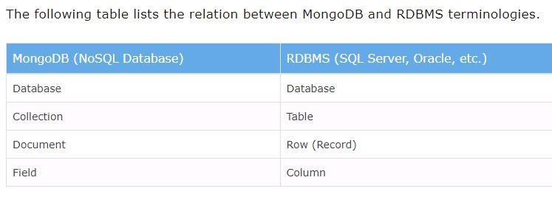
The following table lists the relation between MongoDB and RDBMS terminologies.

Slide 7
In the RDBMS database, a table can have multiple rows and columns.
Similarly in MongoDB, a collection can have multiple documents which are equivalent to the rows.
Each document has multiple "fields" which are equivalent to the columns.
Documents in a single collection can have different fields.

Slide 8
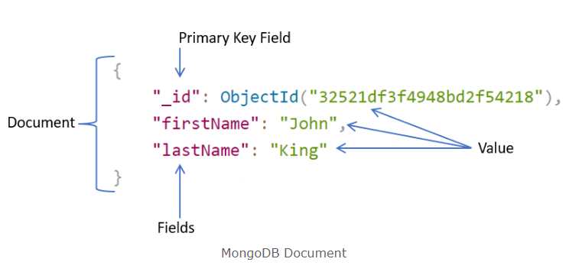
The following is an example of JSON based document.

Slide 9
Advantages of MongoDB
MongoDB stores data as JSON based document that does not enforce the schema.
It allows us to store hierarchical data in a document.
This makes it easy to store and retrieve data in an efficient manner.
It is easy to scale up or down as per the requirement since it is a document based database.
MongoDB also allows us to split data across multiple servers.
MongoDB provides rich features like indexing, aggregation, file store, etc.
MongoDB performs fast with huge data.
MongoDB provides drivers to store and fetch data from different applications developed in different technologies such as C#, Java, Python, Node.js, etc.
MongoDB provides tools to manage MongoDB databases.

Slide 10
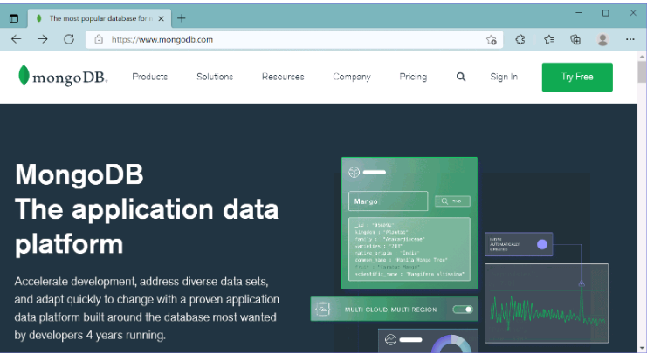
Install MongoDB Server, MongoDB Shell, Compass on Windows
Here you will learn how to install MongoDB server, MongoDB Shell, and compass on your local Windows machine.
Visit www.mongodb.com to download the MongoDB installer for your required platform.

Slide 11
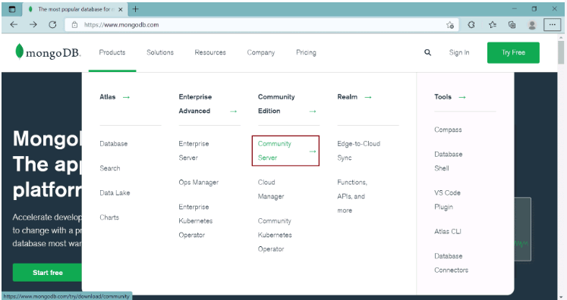
Install MongoDB Server, MongoDB Shell, Compass on Windows
Here, we are going to install a free MongoDB database server on our local Windows machine. So, click on the Product menu -> Community Server, as shown below.

Slide 12
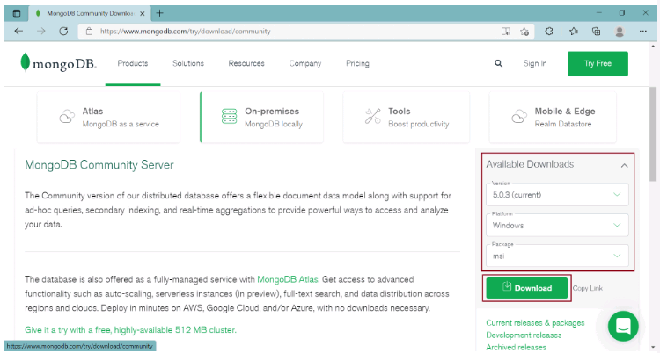
This will open a download page where you can select the version, platform, and package options.
Here, we will download the latest version of MongoDB, Windows platform, and msi file as a package, as shown below.

Slide 13
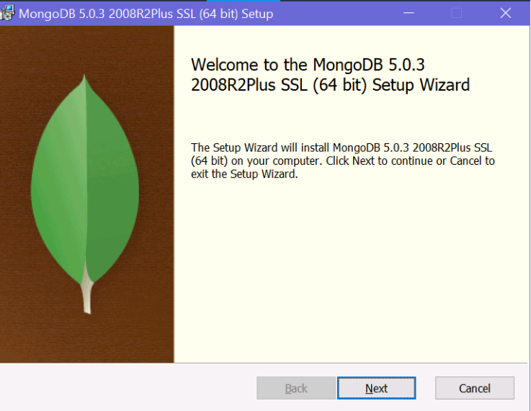
Click on the Download button to download the installer file.
Once fully downloaded, click on the msi file to start the installation wizard, as shown below.

Slide 14
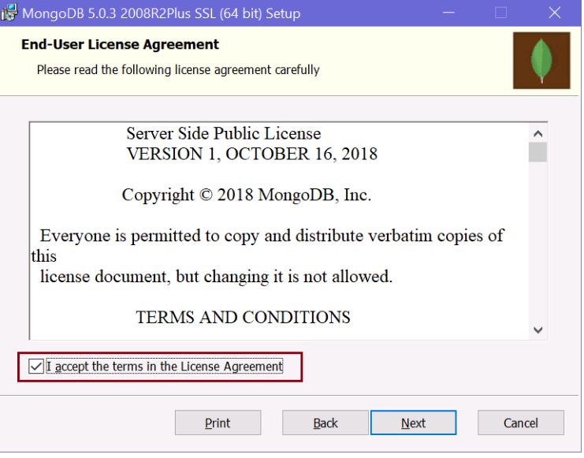
Click Next to start the installation.

Slide 15
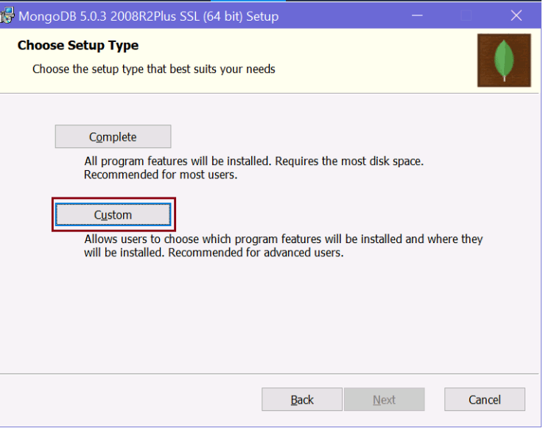
Check the "I accept the terms in the License Agreement" checkbox and click Next..

Slide 16
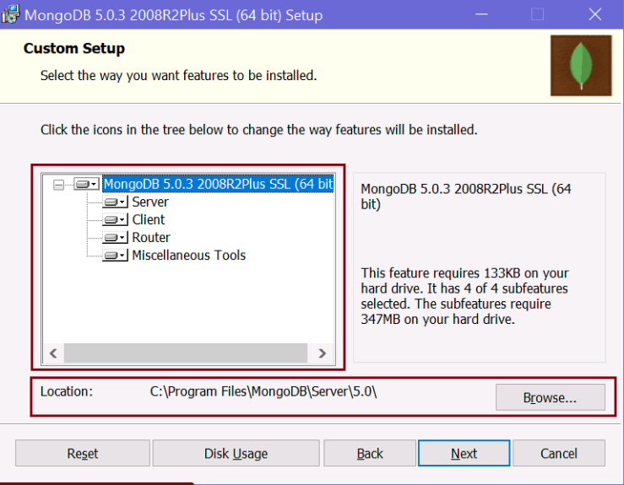
Here, you will have two options for installation: Complete and Custom. The complete option will install all the features. The custom option allows you to select only required features.
You can select either of these two options. Here, we will select the custom option just to show you what all things it will install. So, click on the Custom option which will take you to the next step, as shown below.

Slide 17
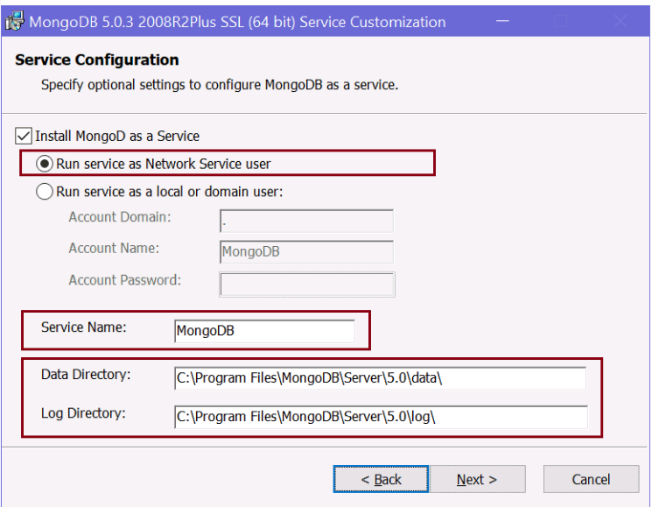
In the custom setup page, expand the MongoDB node to see what all features will be installed. It will install Server, Client, Router, and Miscellaneous Tools for the MongoDB database. It also displays the location where the MongoDB is going to be installed. You may change it or keep the default location and click Next.
Click Next to configure the MongoDB service, as shown below.

Slide 18
MongoDB server will be installed as a service on your local Windows machine.
As you can see above, you have an option to run a service as Network Service user or as a local or domain user.
We will select "Run service as Network Service User" radio button.
You may change the default service name but it is recommended to keep the default "MongoDB" name to identify it easily.
MongoDB database stores the data as BSON files on your local machine.
You can change the default location where the data files and log files are going to be stored.
Here, we will keep the default paths and click the Next button.

Slide 19
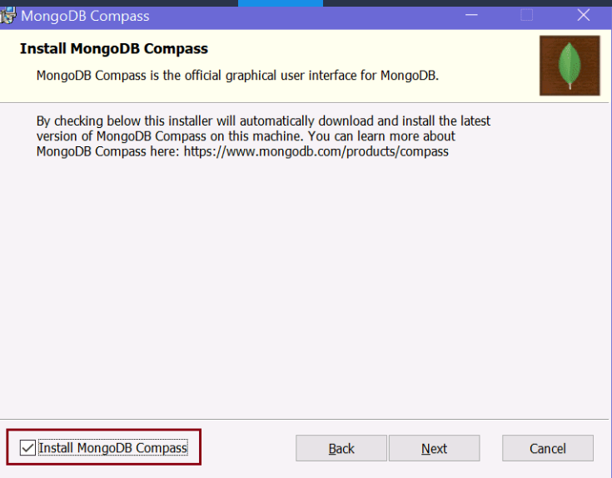
On the next page, select "Install MongoDB Compass" checkbox and click Next. MongoDB Compass is a GUI tool for MongoDB database where you can visually explore data, run queries, and optimize performance.

Slide 20
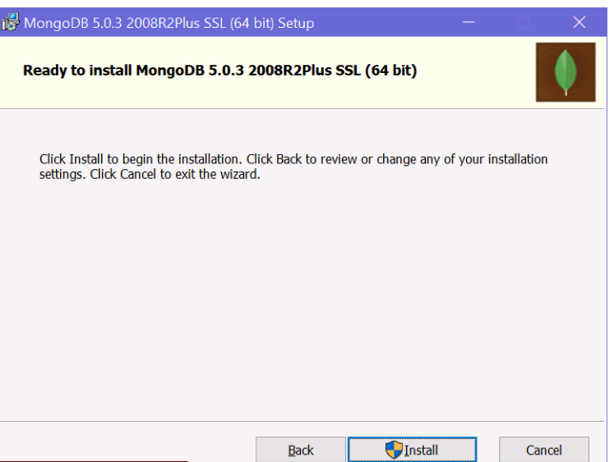
Next, click on the Install button to start the installation.

Slide 21
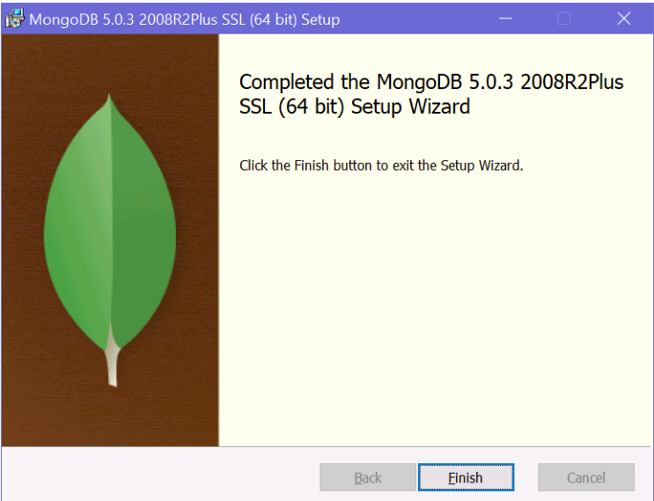
It will take a few minutes to install. Once installed successfully, click on the Finish button to close the wizard.

Slide 22
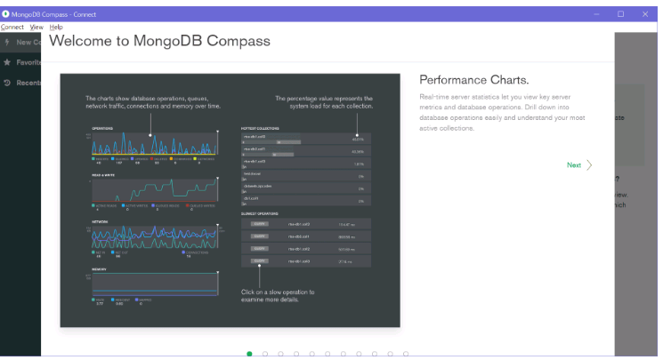
It will also open MongoDB Compass, as shown below.

Slide 23
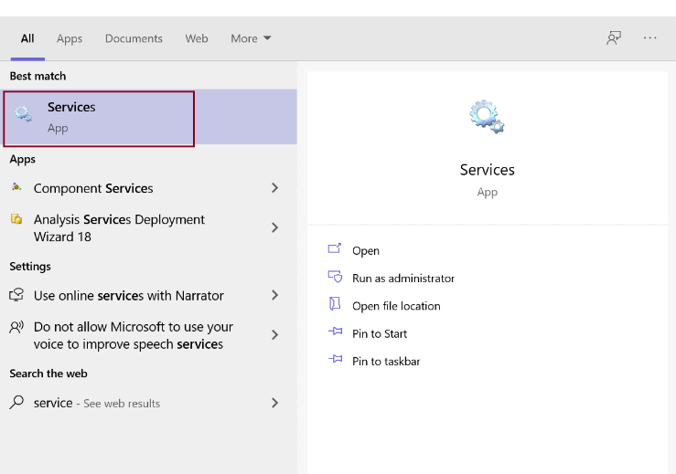
MongoDB Server
We installed MongoDB as a Network service. To see this, open Services by searching "service" in the windows search box and click on the Services app, as shown below.

Slide 24
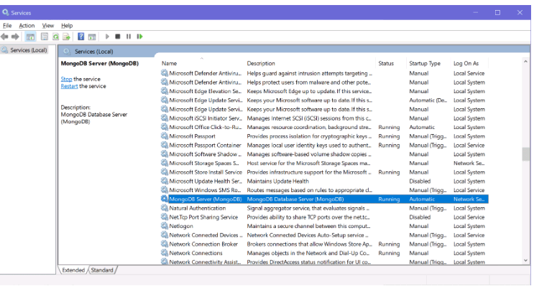
MongoDB Server
On the Services window, navigate to MongoDB Server, as shown below. You will find that it is already up and running.
Now, the MongoDB Server service is already running, you can connect the MongoDB client to connect with this MongoDB server and execute the commands.

Slide 25
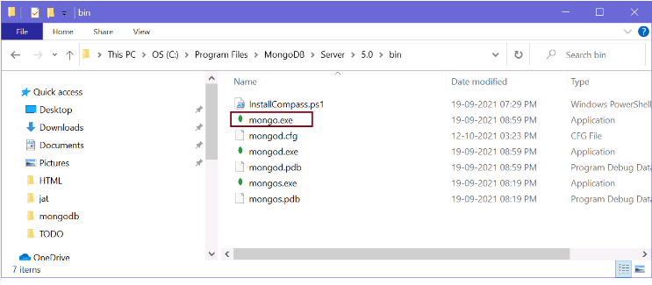
MongoDB Client
MongoDB clients can be your application, MongoDB Shell, MongoDB Compass, or anything which wants to connect and store data to the MongoDB server.
Here, we already installed two clients, MongoDB Shell and MongoDB Compass.
Go to the path where MongoDB was installed. By default it is "C:\Program Files\MongoDB\Server\5.0\bin", as shown below.

Slide 26
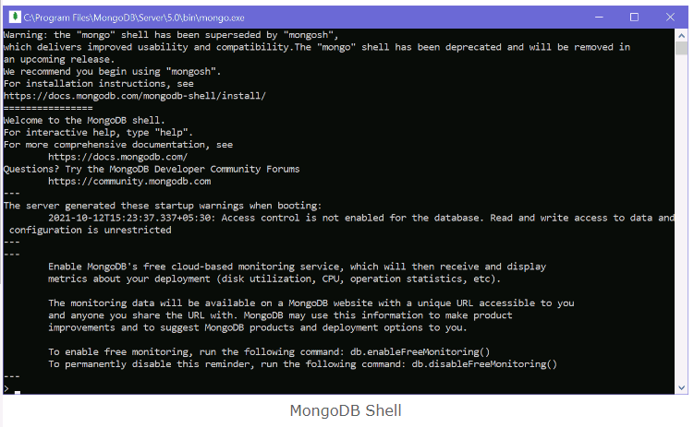
MongoDB Client
Here, you will find mongo.exe, which is MongoDB Shell. Click on mongo.exe to start the client, as shown below.

Slide 27
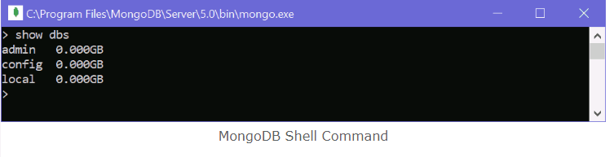
MongoDB Client
You can execute the commands here. For example, write "show dbs" and press Enter to display the database it already has, as shown below.
Thus, you can install the MongoDB server, clients (MongoDB Shell and Compass), and other features.

Slide 28
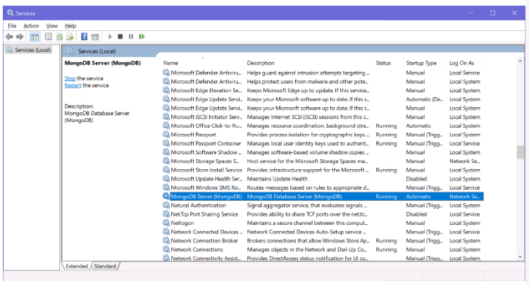
MongoDB Server - mongod, Configurations
Here you will learn what is MongoDB server, how to run it manually, and how to set various configuration settings for your MongoDB server.
We installed the MongoDB server as a Windows service in the Install MongoDB chapter. MongoDB windows service is automatically up and running at startup, as shown below.

Slide 29
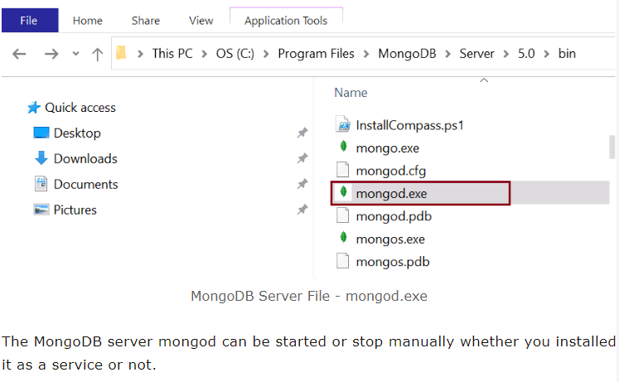
MongoDB Server - mongod, Configurations
Internally, the MongoDB service starts the local MongoDB server at the default address http://127.0.0.1:27017 whenever your machine starts. MongoDB server is installed as mongod.exe on Windows in the {mongodb install folder}/bin folder, as shown below.

Slide 30
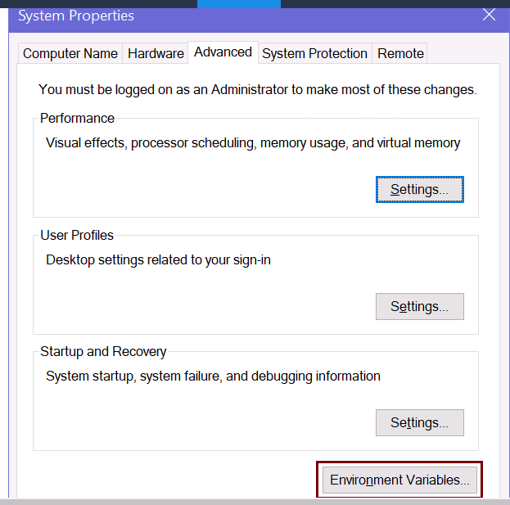
Run mongod Manually
If you have installed MongoDB as a windows service then stop the service first as we are going to start it manually.
Now, add {mongodb install folder}/bin to your environment variable on your local Windows machine. Search for "Environment" on windows search and click "Edit the system environment variable" to open system properties, as shown below.

Slide 31
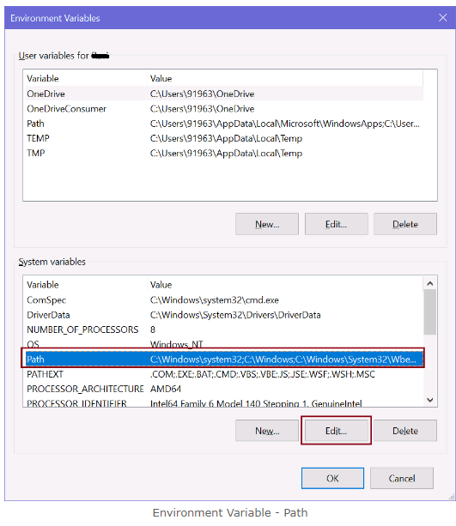
Run mongod Manually
Click on "Environment Variables.." to edit path, as shown below.

Slide 32
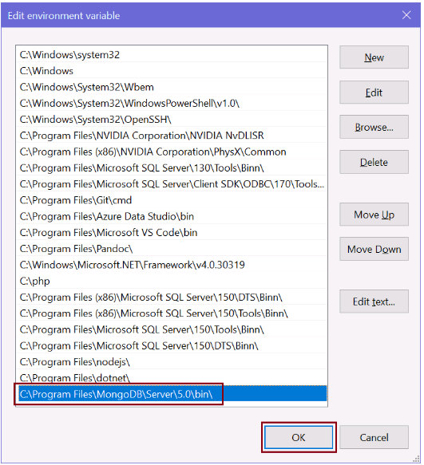
Now, select Path in the bottom pane and click on the Edit button. This will open "Edit environment variable" window. Click on the New button to add MongoDB folder path "C:\Program Files\MongoDB\Server\5.0\bin\", as shown below.

Slide 33
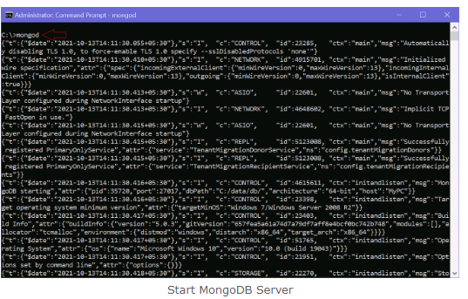
Click OK to close all pop-up windows.
Adding MongoDB folder path to environment variable allow us to run mongod.exe from anywhere on command prompt/terminal.
Now, open a command prompt on Windows or terminal as an administrator and execute the mongod on Windows or sudo mongod on Mac to run your MongoDB server, as shown below.

Slide 34
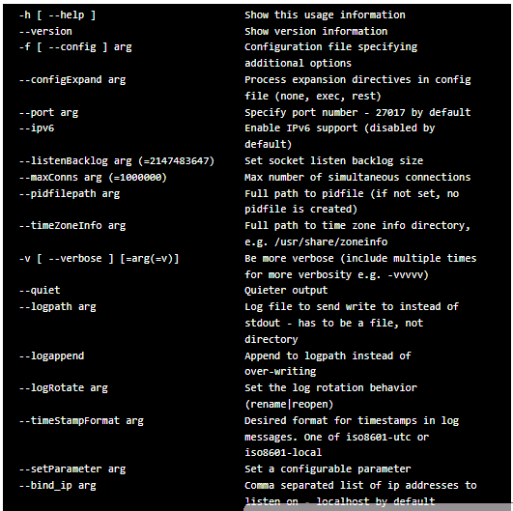
You can specify various command options with mongod command for testing purposes. The following is list of some useful command options.

Slide 35
MongoDB Server Configuration
MongoDB uses the configuration file options to control the behavior of a database.
MongoDB server mongod runs with the default configurations added in the config file.
On Windows, it is {install directory}\bin\mongod.cfg file. On MacOS, it is /usr/local/etc/mongod.conf or /opt/homebrew/etc/mongod.conf.
And, on Linux, it is /etc/mongod.conf file. MongoDB configuration files use the YAML format.
The following is the mongod.cfg file on Windows:

Slide 36
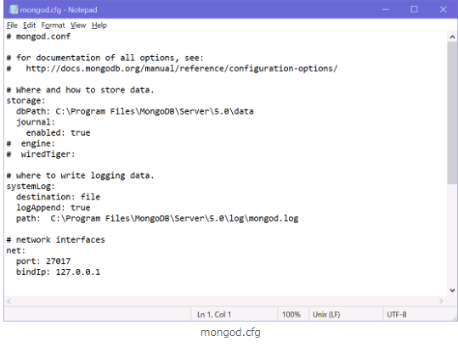
MongoDB Server Configuration

Slide 37
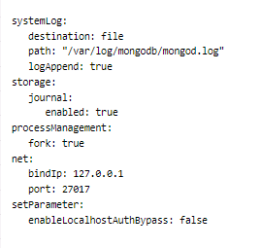
MongoDB Server Configuration
The following is the sample config file which you may like to use for your local mongod server.

Slide 38
MongoDB Shell
MongoDB Shell is the quickest way to connect, configure, query, and work with your MongoDB database.
It acts command-line client of the MongoDB server.
The MongoDB Shell is a standalone, open-source product and developed separately from the MongoDB Server under the Apache 2 license.
It is a fully functional JavaScript and Node.js 14.x REPL for interacting with MongoDB servers.
MongoDB Shell is already installed with MongoDB. You can find it in the installation directory where you installed MongoDB.

Slide 39
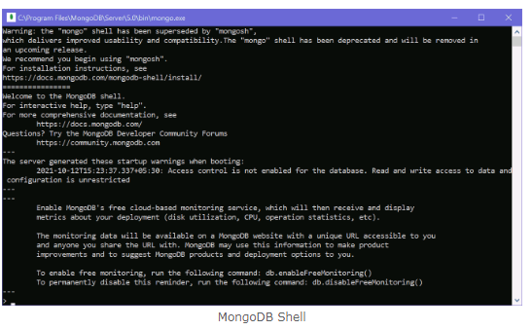
By default, it is "C:\Program Files\MongoDB\Server". Open the installation folder and appropriate version folder and go to the "bin" folder. Here, "mongo.exe" is MongoDB shell. Click on it to open the MongoDB shell, as shown below.

Slide 40
New MongoDB Shell - mongosh
In the installation folder, if you find mongosh.exe instead of mongo.exe then you already have a new MongoDB shell.
If you don't find it, then you need to install it separately.
The new MongoDB Shell mongosh has some more features than old shell mongo such as intelligent autocomplete and syntax highlighting, easy to understand error messages, formatting feature to present the output in a readable format, etc. However, all the commands will be executed in mongosh as well as mongo shell.

Slide 41
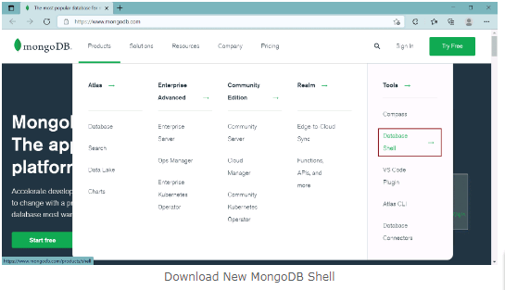
Install mongosh
To install the new MongoDB shell (mongosh), visit www.mongodb.com and click on Product menu -> Tools -> Database Shell, as shown below.

Slide 42
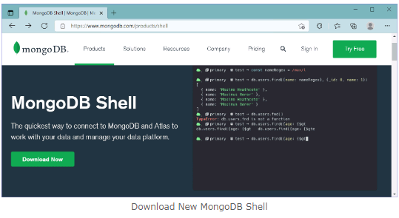
Install mongosh
On the MongoDB Shell page, click on the Download button to download the shell.

Slide 43
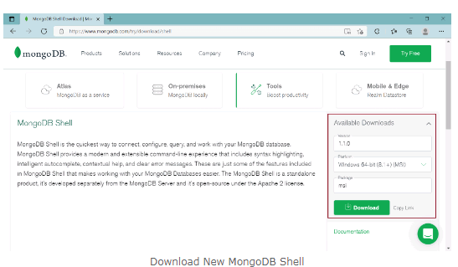
Install mongosh
This will take you to a page where you can select a version, platform, and package to download, as shown below.

Slide 44
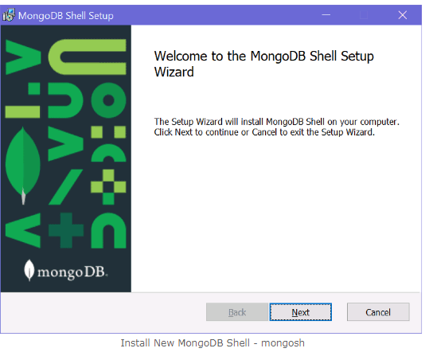
Click on the Download button to download the installer file.
Now, click on the downloaded installer file to start the installation wizard, as shown below.

Slide 45
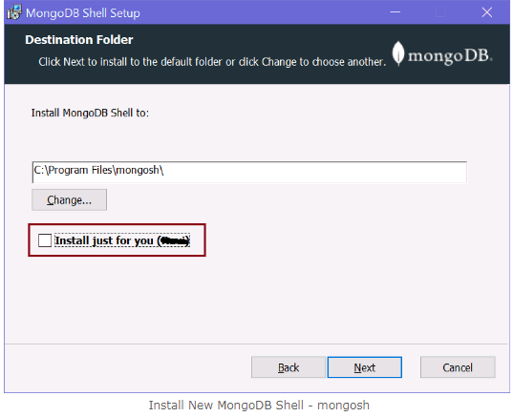
Click Next to go to next step shown below.

Slide 46
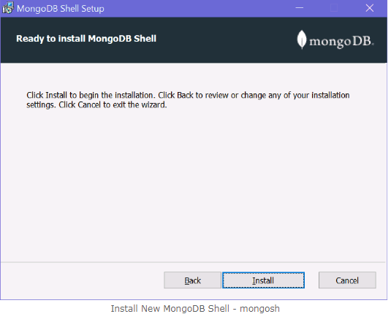
Here, uncheck the checkbox if you want to install shell for all users on your local machine and click Next.

Slide 47
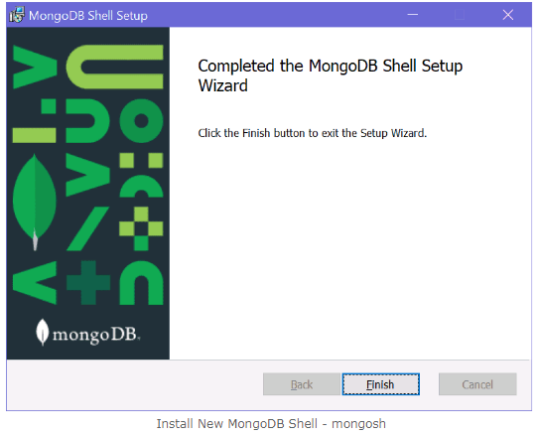
Click on the Install button to start the installation. It should quickly install it.

Slide 48
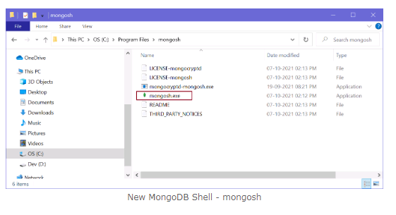
Once installation completes, click the Finish button to close the wizard.
This should have installed mongosh in "C:\Program Files\mongosh" folder on Windows, as shown below.

Slide 49
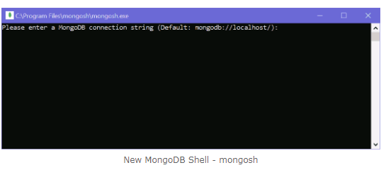
Click on the mongosh.exe to open a new MongoDB shell, as shown below.

Slide 50
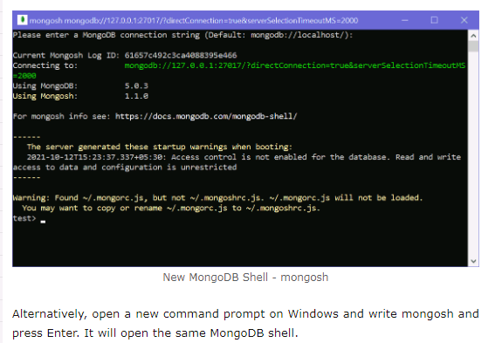
Press Enter to start the shell, as shown below.
.

Slide 51
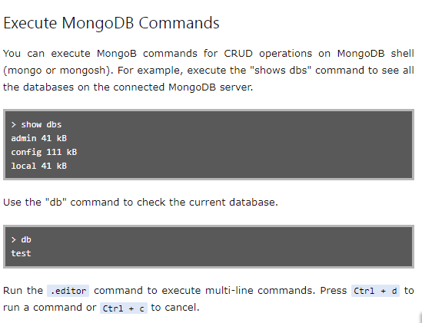
.

Slide 52
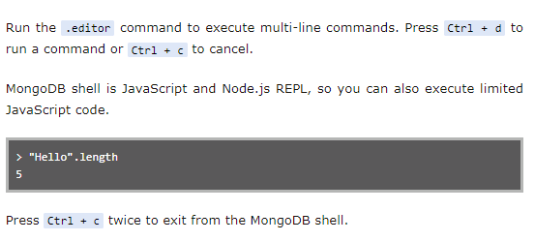
.

Slide 53

MongoDB Shell Commands
MongoDB Shell is the quickest way to connect, configure, query, and work with your MongoDB database.
It acts as a command-line client of the MongoDB server.
You can start MongoDB Shell by executing mongo or mongosh command on the command prompt/terminal.
mongosh is the new MongoDB shell with some more features than the old mongo shell.

Slide 54
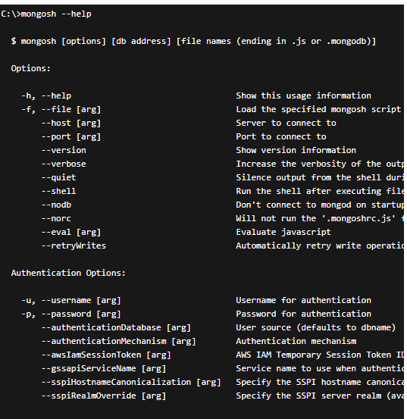
MongoDB Shell Commands
The --help command display all the commands which you can use with mongo or mongosh, as shown below.

Slide 55
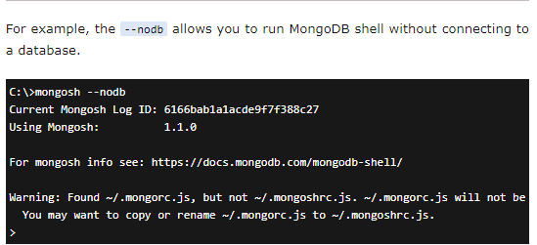
MongoDB Shell Commands
The --help command display all the commands which you can use with mongo or mongosh, as shown below.

Slide 56
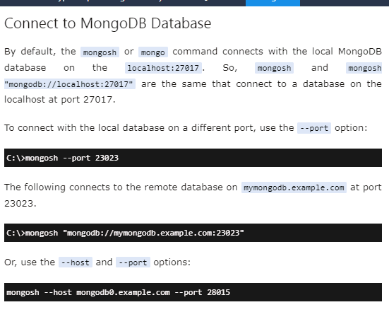
MongoDB Shell Commands

Slide 57
MongoDB Shell Commands
Use the --username and --authenticationDatabase command-line options to connect with the database that requires authentication.
mongosh "mongodb://mymongodb.example.com:23023" --username steve --authenticationDatabase admin

Slide 58
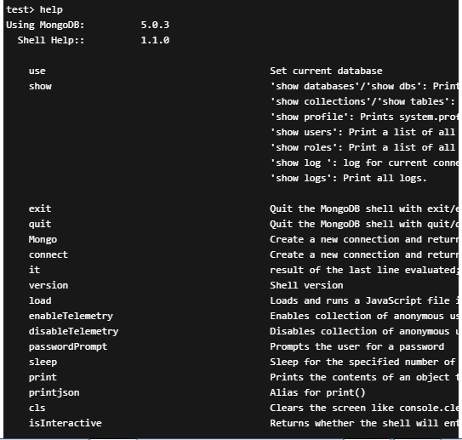
MongoDB Command Help
You can also get help on mongosh or mongo commands after connecting to a database using the help command, as shown below.

Slide 59
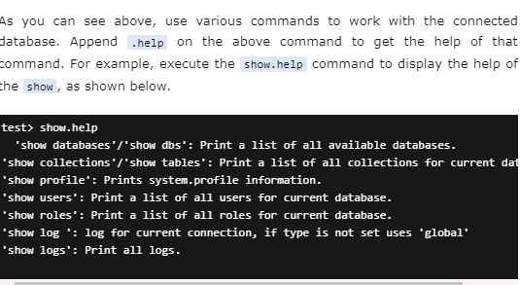
MongoDB Command Help
You can also get help on mongosh or mongo commands after connecting to a database using the help command, as shown below.

Slide 60
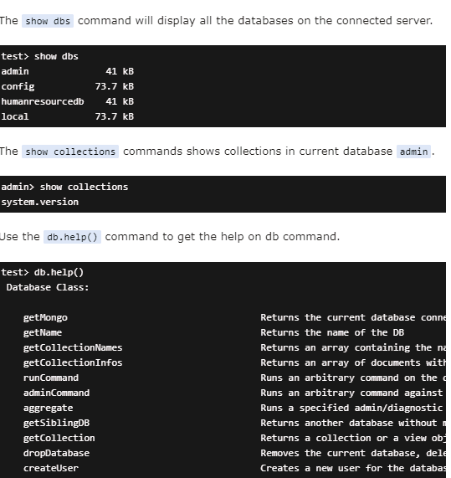
MongoDB Command Help
You can also get help on mongosh or mongo commands after connecting to a database using the help command, as shown below.

Slide 61
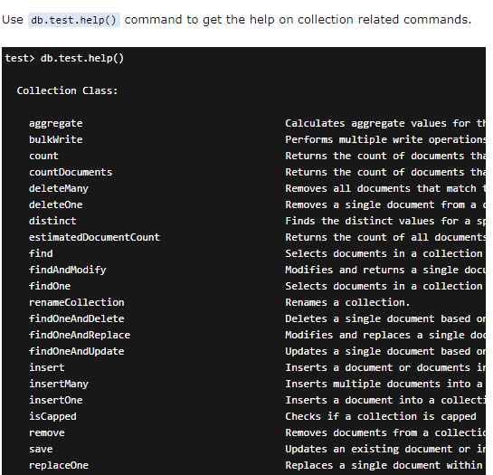

Slide 62
MongoDB Compass
MongoDB Compass is a GUI based tools (unline MongoDB Shell) to interact with local or remote MongoDB server and databases.
Use Compass to visually explore your data, run ad hoc queries, perform CRUD operations, and view and optimize your query performance.
It can be installed on Linux, Mac, or Windows.

Slide 63
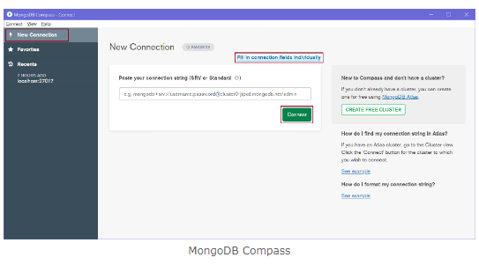
MongoDB Compass

Slide 64
MongoDB Compass
On the main page, click on the New Connection tab on the left pane to open New Connection page shown above.
You can paste a connection string or click on Fill in connection fields individually link.
This will open the following window where you can enter the host name, port, username, password, etc.

Slide 65
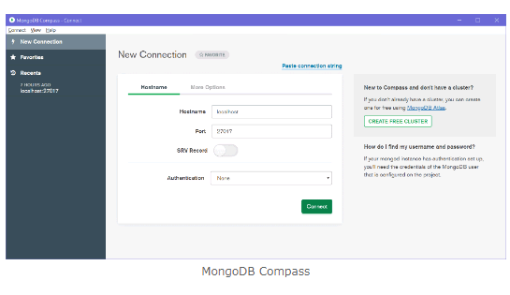
MongoDB Compass

Slide 66

MongoDB Compass
This already has default parameters, just click OK to connect with your local server, as shown below.

Slide 67
MongoDB Compass
As you can see above, it will display all the databases on the connected MongoDB server.
On the left pane, it displays information about the connected server.
Now, you can create, modify, delete databases, collections, documents using MongoDB Compass.
Click on the CREATE DATABASE button to create a new database.
This will open Create Database popup, as shown below.

Slide 68

MongoDB Compass

Slide 69

MongoDB Compass
Enter your database name and collection name and click Create Database.
This will create a new database humanResourceDB with the new employees collection shown below.

Slide 70

MongoDB Compass
Click on employees collection to insert, update, find documents in it.
This will open the following window to manage documents.
MongoDB Compass - Manage DocumentsThus, you can use MongoDB Compass UI to manage your MongoDB databases.

Slide 71



Thank You

